Slide 1
Introduction to GPU Architecture

Slide 2
NVIDIA Case Study
• NVIDIA is a leading company in GPU and AI computing.
• Founded in 1993.
• Known for GeForce GPUs, CUDA platform, and AI accelerators.
• GPUs enable parallel processing for graphics, AI, and scientific computing.
• Used in gaming, autonomous vehicles, deep learning, and data centers.

Slide 3
Introduction to Supercomputers
• Supercomputers are the most powerful computers designed for high‑performance computing.
• Used for complex simulations and large scientific problems.
• Perform trillions of calculations per second (petaflops or exaflops).
• Applications: climate modeling, weather forecasting, medical research, and space exploration.

Slide 4
Graphics Processing Unit
Like a motherboard, a graphics card is a printed circuit board that houses a processor and RAM.
It also has an input/output system (BIOS) chip, which stores the card's settings and performs diagnostics on the memory, input and output at startup.
A graphics card's processor, called a graphics processing unit (GPU), is similar to a Computer's CPU.
A GPU, however, is designed specifically for performing the complex mathematical and geometric calculations that are necessary for graphics rendering.
Some of the fastest GPUs have more transistors than the average CPU. A GPU produces a lot of heat, so it is usually located under a heat sink or a fan.

Slide 5
Graphics Processing Unit
A GPU however is more dedicated in function. It takes that same function that a CPU was processing and completes it all at once.
The specified function requested of a GPU enters the GPU's hundred's of cores, and processes all at a single point in time, where it handles each process parallel to the next.
The GPU has become the most powerful processing unit of the system, especially since organizations are beginning to rely more on the processing power of a GPU rather than a CPU for the single fact that it can process more at a single point in time faster than a CPU.

Slide 6
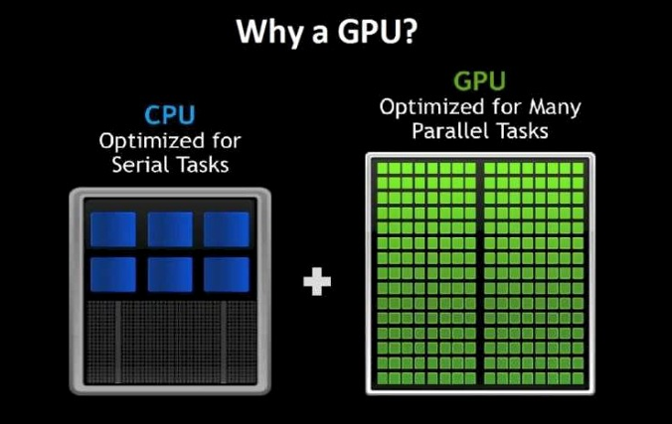
There are two different types of GPUs:
Integrated GPUs are located on a PC's CPU and share memory with the CPU processor.
Discrete GPUs live on their own card and have their own video memory (VRAM), so that the PC doesn't have to use its RAM for graphics.

Slide 7
Processors on Handheld devices
ARM processor
An ARM processor is one of a family of CPUs based on the RISC (reduced instruction set computer) architecture developed by Advanced RISC Machines (ARM).
ARM makes 32-bit and 64-bit RISC multi-core processors. RISC processors are designed to perform a smaller number of types of computer instructions so that they can operate at a higher speed, performing more millions of instructions per second (MIPS).
By stripping out unneeded instructions and optimizing pathways, RISC processors provide outstanding performance at a fraction of the power demand of CISC (complex instruction set computing) devices.

Slide 8
Processors on Handheld devices
ARM processors are extensively used in consumer electronic devices such as smartphones, tablets, multimedia players and other mobile devices, such as wearables. Because of their reduced instruction set, they require fewer transistors, which enables a smaller die size for the integrated circuitry (IC).
The ARM processor's smaller size, reduced complexity and lower power consumption makes them suitable for increasingly miniaturized devices.

Slide 9
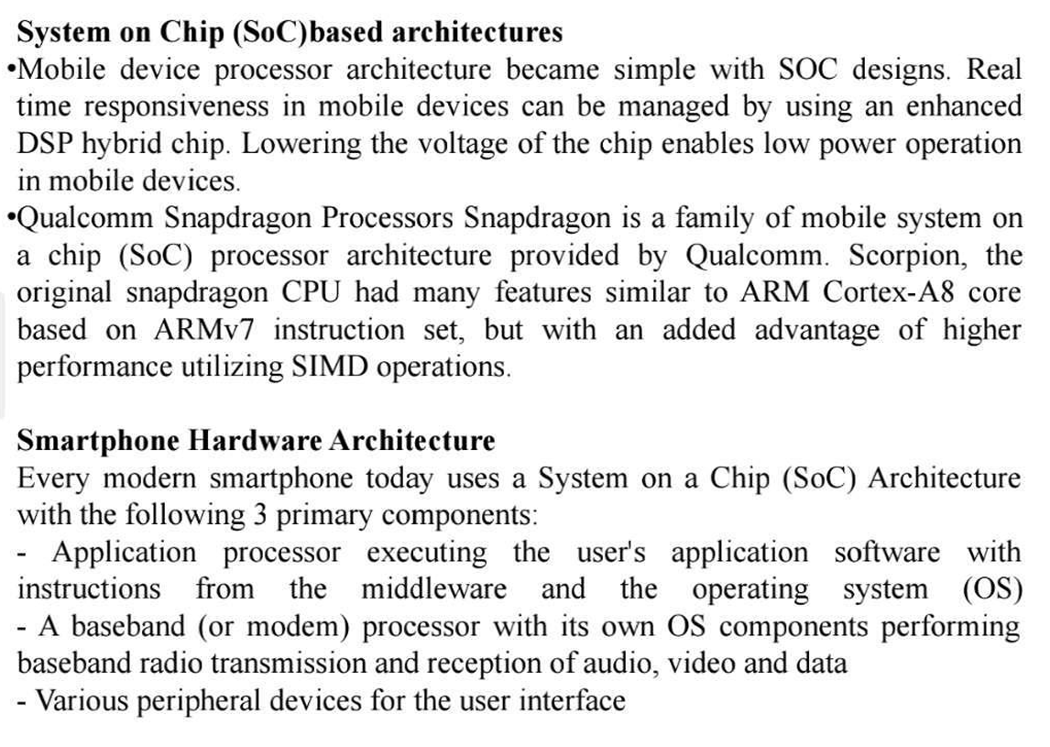
System on Chip (SoC) based architectures

Slide 10
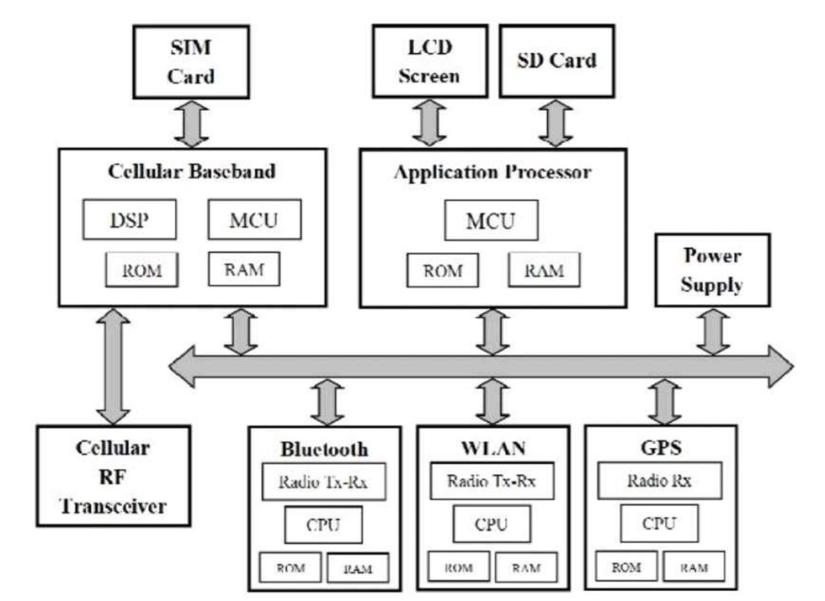
Basic Smartphone architecture

Slide 11
Introduction to Qubits and Quantum Computing
• Quantum computing uses principles of quantum mechanics.
• Basic unit of quantum information is the Qubit.
• Unlike classical bits (0 or 1), qubits can exist in superposition.
• Quantum computers can solve certain problems much faster than classical computers.
• Used in cryptography, optimization, and drug discovery.

Slide 12
Latest Technology Trends in Computer Architecture
• Artificial Intelligence accelerators
• Cloud computing and edge computing
• Heterogeneous computing (CPU + GPU + AI chips)
• Energy‑efficient processor design
• Quantum and neuromorphic computing research

Slide 13
Next Generation Processor Architecture
• Focus on high performance and low power consumption.
• Use of multi‑core and many‑core processors.
• Integration of AI and machine learning accelerators.
• Advanced semiconductor technologies (5nm, 3nm).
• Improved memory hierarchy and cache systems.

Slide 14
Microarchitecture
• Microarchitecture defines how a processor is internally implemented.
• Includes ALU, registers, control unit, and cache memory.
• Determines how instructions are executed inside the CPU.
• Techniques include pipelining, superscalar execution, and branch prediction.

Slide 15
Latest Processors for Smartphones and Tablets
• Apple A‑series processors (A17, etc.)
• Qualcomm Snapdragon processors
• Samsung Exynos processors
• MediaTek Dimensity processors
• Designed for high performance with low power consumption.

Slide 16
Latest Desktop Processors
• Intel Core series (Core i5, i7, i9 – latest generations)
• AMD Ryzen processors
• High‑performance CPUs used for gaming, development, and professional workloads.
• Features include multiple cores, high clock speeds, and advanced caching.

